Slide 1
Delivery Prediction case Study

Slide 2
Overview of the project
An international e-commerce company based in the USA wants to discover key insights from their customer database. They want to use some of the most advanced machine learning techniques to study their customers. The company sells electronic products.
The train dataset used for model building contained 10999 observations of 12 variables, and the test dataset used for predicting the target variable contained 3993 observations of 12 variables.
The project is divided into 4 problem statements. Each of the problem is unique and requires the project candidate to utilize various Data Science skills to solve them.

Slide 3
Problem statements in focus
1. Classification : Build various classification models like Logistic Regression, Support Vector Machines, Random Forests, and XGBoost/Any boosting techniques to predict if the shipments have reached the customer on-time or not. Identify the model with the best accuracy and find the significant variables that impact the target variable.
2. Data visualization: Use ggplot2 to illustrate if the shipments have reached on-time for the customers who have the best customer rating, the best customer score, made recurring orders and high payments.

Slide 4
Problem statements in focus
3. Clustering: Create segmentation of the customers to whom the shipments have not reached on-time. Use only delayed customers data for clustering.
4. Twitter sentiment analysis: Do a Sentiment analysis(Positive or Negative) of the competitors: Amazon India, Flipkart, and Snapdeal. Use tweets to perform the analysis.

Slide 5
Project study – in brief
Researched about what factors affected on-time delivery of shipments.
Interviewed delivery personnel to understand what factors delay their delivery.
Monitored the movement of orders through order tracking feature available in shopping apps.
Read articles about important KPIs for e-commerce.
Read articles about how data is helping e-commerce businesses.

Slide 6
understanding the business problem
The primary goal of any e-commerce company is to satisfy a customer’s need at the end of an interaction. This is where on-time delivery comes into picture.
On-time delivery of shipment is an important metric in the logistic segment of the e-commerce industry.
If on-time delivery is predicted, effective allocation of resources can be achieved.
Customer satisfaction and long term relationship are only possible if the shipments are delivered on-time.
About the company : The company operates in various states of USA, but the customer data is only specific to one state in the USA.
Their warehouse is located on the eastern part whereas, the state to which shipments are delivered is at the western part of the USA.

Slide 7
Data preparation
The dataset for model building contained 10999 observations of 12 variables.
A copy of the original dataset was created for further analysis.
The ID variable contained unique values and corresponded with the row numbers. Hence, it was removed.
The variable names were edited for aesthetic reason.
The structure and summary of the dataset were observed.
The target variable – reached on time was converted into factor. Predictor variables such as customer care calls, customer rating, and prior purchases were also converted to factors.
The dataset was checked for missing values. There were no missing values. These preliminary measures were also leveraged on the test dataset before prediction. (with respect to Problem 1)

Slide 8
Data exploration - initial observation
The shipments that were delivered on-time were indicated as 0, and delayed shipments were indicated as 1.
The outcome variable had 4436 shipments that reached on-time, while 6563 shipments didn’t reach on-time.
It was observed that the company had an on-time delivery rate of 40.33 % as compared to delayed delivery rate of 59.66 %. Significant number of shipments didn’t reach customers on-time.
Average order value was 210.19 US Dollars. It is the average amount a customer ends up spending per transaction. To improve this value, the e-commerce company should recommend relevant products, set order minimums for discount/free shipping, and bundle products.
Minimum weight of an order was 1001 grams. Maximum weight was found to be 7846 grams.

Slide 9
Data exploration - initial observation
Maximum no. of customers in the dataset had made prior purchases of three products. Minimum no. of customers had made prior purchases of eight products.
Revenue generated by customers who made three prior purchases was found to be approx. $ 791K. Whereas, the revenue generated by customers who made eight prior purchases was found to be $ 25K.
Most activity from the F block of the warehouse.
A large share of deliveries were done with ships.
Maximum no. of customers in the dataset have made 4 calls to customer care.
Majority of customers were rated 3, followed by customers who were rated 1. About 882 customers who were rated 3, received their orders on-time.
Maximum discount offered by the company was 65 %, and minimum discount offered was 1 %.
Majority of products were of low importance.
The purchase with the highest value was found to be $ 310.

Slide 10
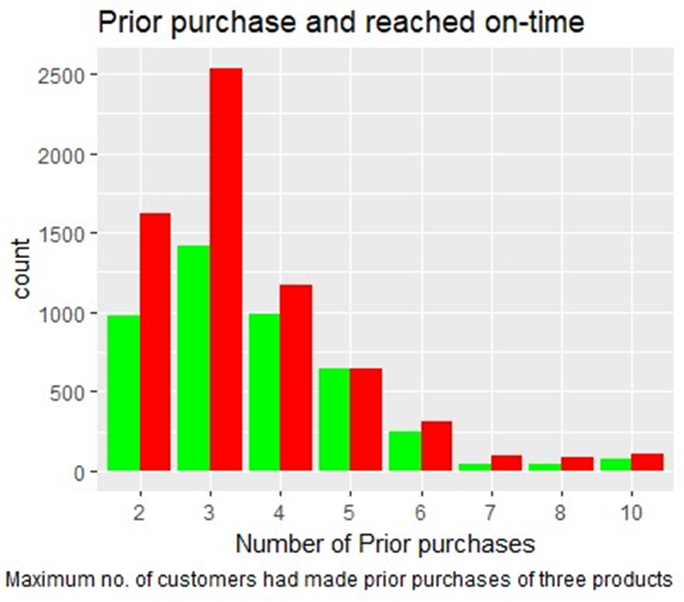
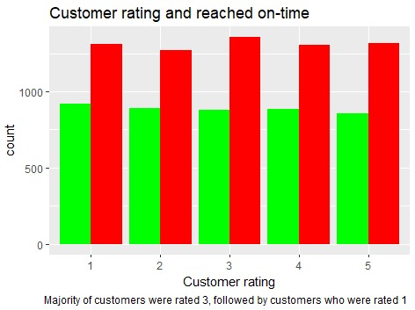
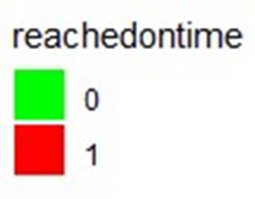
Data visualization
Per the dataset, 0 indicates shipments reached on-time and 1 indicates shipments didn’t reach on-time.

Slide 11
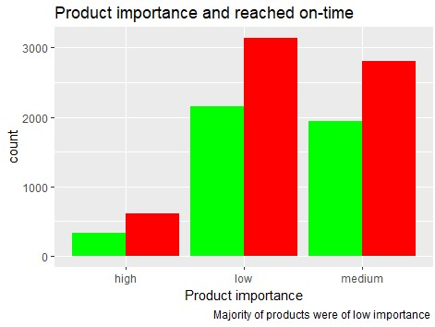
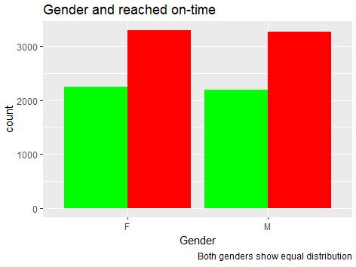
Data visualization

Slide 12
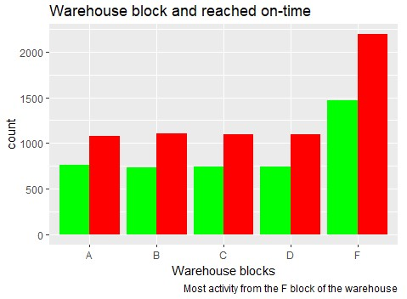
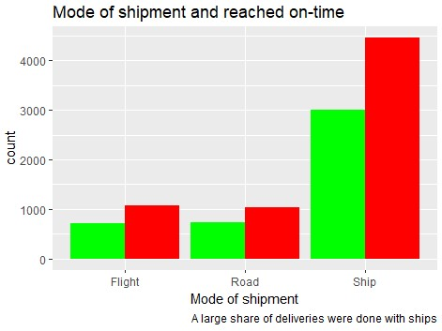
Data visualization

Slide 13
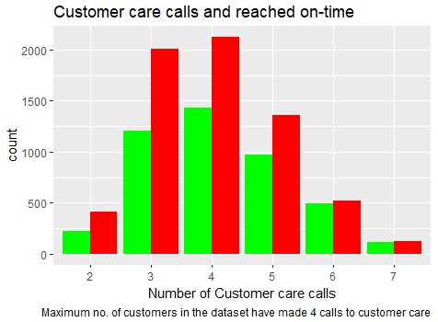
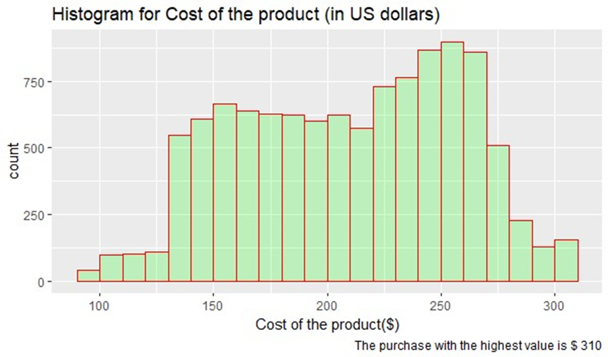
Data visualization
Most purchases made by the customers are valued between $ 230 - $ 270. The variable has a normal distribution.

Slide 14
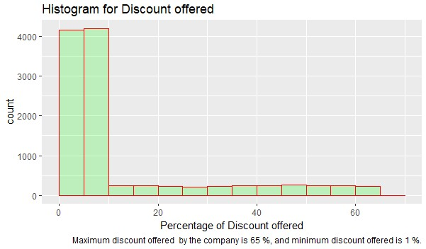
Data visualization
The variable is positively skewed.

Slide 15
Problem statement 1 and insights
Problem statement: The company wanted the candidate to build various classification models and compare their accuracy. The main model requested to be built were Logistic regression, Support Vector machines, Random forest, and XGBoost. Apart from comparing the accuracy of these models, identify significant variables that impact the model.

Slide 16
Logistic Regression
model1 (Base model) | Included all the variables in the model. AIC : 8387.8 | 64.48 %
stepmodel1 (Stepwise model) | Updated base model 1. Only significant variables included. AIC : 8370.7 | 66.55 %
Observation : Stepwise model performed fairly better than the base model with an accuracy of 66.55 % and includes only significant variables.
Significant variables: Customer care calls, cost of the product, prior purchase, product importance, discount offered, and weight in grams.

Slide 17
Support Vector Machines
fit1 (Model 1) | Included all the variables in the model. Tuning parameter Cost held constant at 1. | 66.08 %
fit2 (Model 2) | Tuning parameter Cost value was set at various values – 0.5, 1, 1.5, 2, 5, 5.5, 10, 10.5, 11, 15. Cost value set at 5.5 gave fairly better accuracy over others. | 66.18 %
fit3 (Model 3) | Only significant variables were included. Tuning parameter Cost value set at 5.5 | 66.24 %
Observation : Model 3 performed better than other SVM models with an accuracy of 66.24 %.
Significant variables: Discount offered, weight in grams, cost of the product, prior purchase, customer care calls, and product importance.

Slide 18
Random Forest
Model_rf | Used dataset without splitting into train and test since random forest does internal validation. 2/3 of the dataset is sampled for training. While 1/3 of the dataset (OOB) is used for testing. The latter is called the Out of bag sample. | 64.06 %
Observation : Model gave an out of bag estimate of error as 33.94 %. Which means accuracy is 66.06%.
Significant variables: Weight in grams, discount offered, cost of the product, warehouse block, customer rating, and prior purchase.

Slide 19
XGBoost
model1 (Base model) | Train and test data were converted to matrix before building the model. Parameters were tuned prior to training the model. | 68.27 %
stepmodel1 (Stepwise model) | Updated base model 1. Only significant variables included. AIC : 8370.7 | 66.55 %
Observation : Model gave an accuracy of 68.27 % which is significantly better than the performance of other models – Logistic regression, Support Vector Machines, and Random Forest.
Significant variables: Discount offered, weight in grams, prior purchase, cost of the product, customer care calls, and product importance.

Slide 20
Insights
Comparing the accuracy of all the classification models so far, XG Boost performed better. It is significantly better than the other models in predicting if shipments reached on-time or not.
All the models identified 6 variables as significant. They are discount offered, weight in grams, prior purchase, cost of the product, customer care calls, and product importance.

Slide 21
Problem statement 2 and insights
Problem statement: Use ggplot2 to illustrate if the shipments have reached on-time for the customers who have the best customer rating, the best customer score, made recurring orders and high payments.

Slide 22
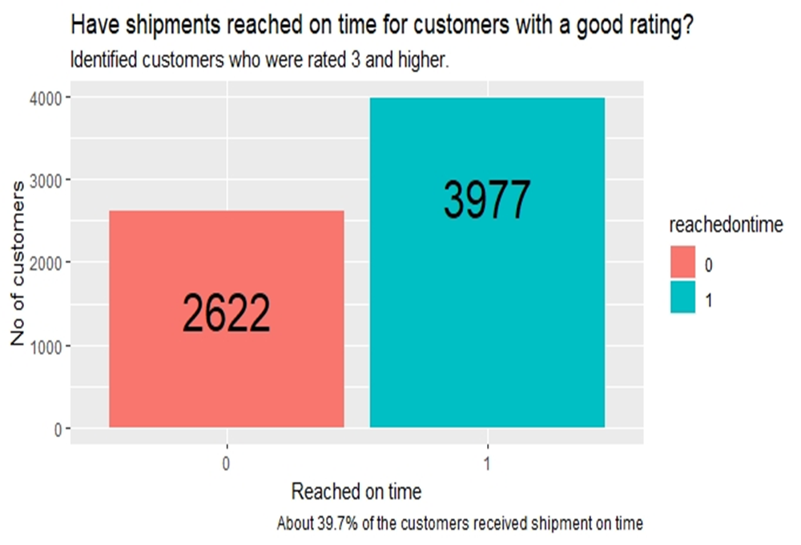
Best customer rating: Customers were identified who were rated 3 and higher. Used the filter function from the dplyr package to satisfy this criteria. The subset of the original dataset containing the best rated customers were visualized with respect to the target variable. The subset “good_rating” contained 6599 observations from the original 10999 observations.
The target variable classes were labelled as Yes for 0 and No for 1. 0 indicates reached on-time, and 1 indicates not reached on-time.
INSIGHTS
Here 39.7% indicates on-time delivery rate, which is very low.
Remaining 60.09 % customers who were also rated 3 and higher didn’t receive their shipments on time.

Slide 23
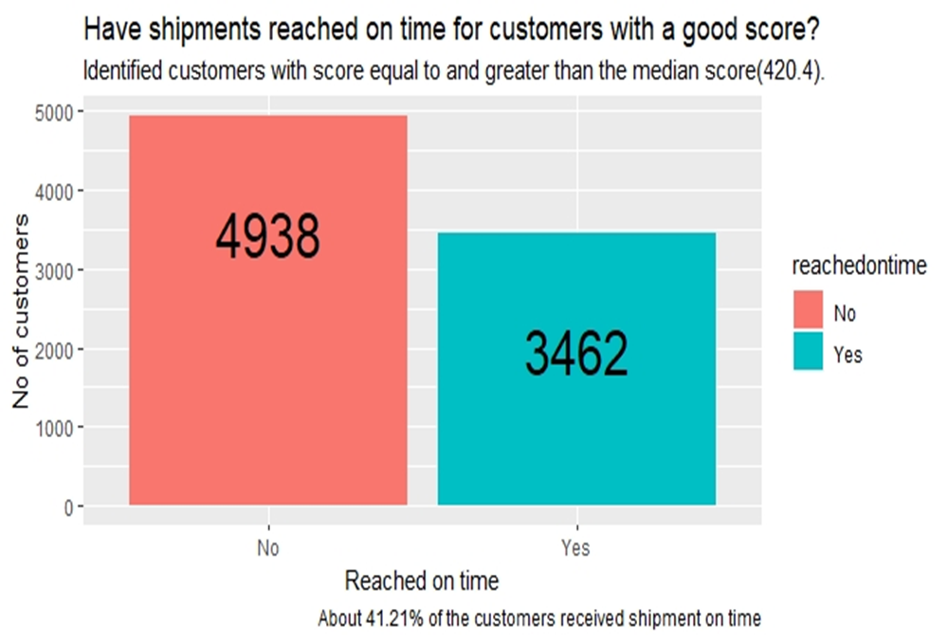
Best customer score: On slide 10, the average order value was calculated, and was found to be $ 210.19. Customer scores were calculated by multiplying average order value with prior purchase (Frequency) for each customer. For a customer to have a best score, he/she must should have a score greater than the median score. To satisfy this criteria, a subset of the original dataset was filtered using the filter function. The subset “best_customerscore” contained 8400 observations from the original 10999 observations.
The target variable classes were labelled as Yes for 0 and No for 1. 0 indicates reached on-time, and 1 indicates not reached on-time.
INSIGHTS
Here 41.21% indicates on-time delivery rate, which is very low compared to delayed delivery rate which was found to be 58.78 %.
Shipments have not been reaching on time for majority of customers who had the best scores.

Slide 24
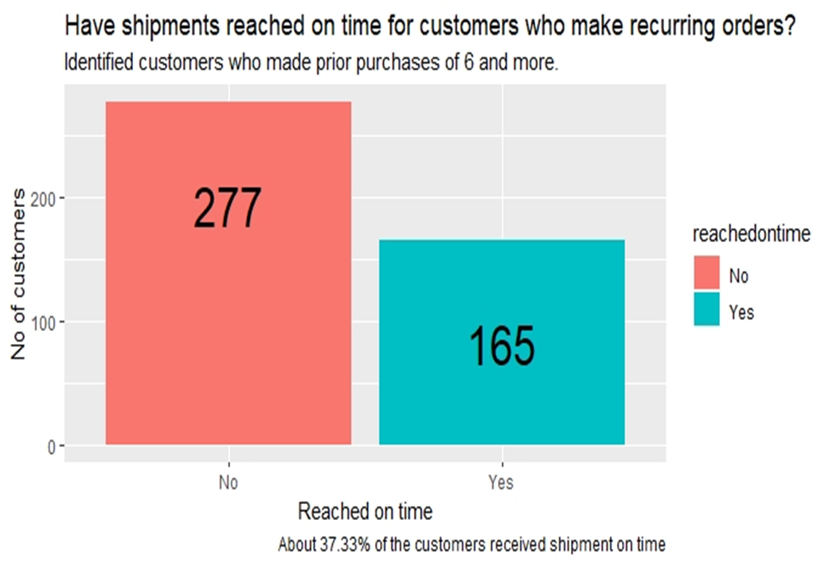
Recurring orders: Customers who made 6 prior purchases and more were considered important for the analysis. To satisfy this criteria, a subset of the original dataset was filtered using the filter function from the dplyr package. The subset “recurring_orders” contained only 422 observations from the original 10999 observations. This is indeed a small subset of customers.
The target variable classes were labelled as Yes for 0 and No for 1. 0 indicates reached on-time, and 1 indicates not reached on-time.
INSIGHTS
Here 37.33% indicates on-time delivery rate, which is very low compared to delayed delivery rate which was found to be 62.66 %.
Shipments have not been reaching on time for majority of customers who made recurring purchases.

Slide 25
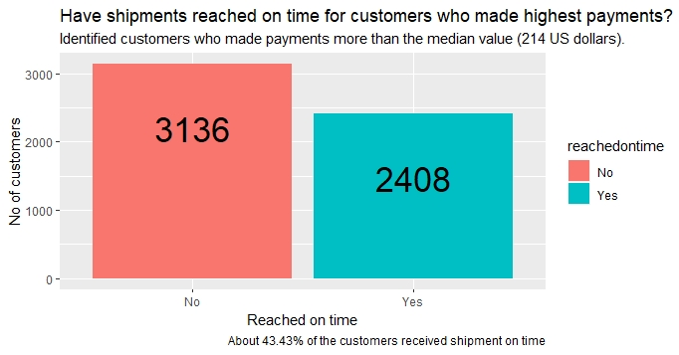
Highest payments: Customers who made payments greater and equal to the median value were considered important for the analysis. To satisfy this criteria, a subset of the original dataset was filtered using the filter function from the dplyr package. The subset “highest_payments” contained only 5544 observations from the original 10999 observations. The median value was found to be 214 US dollars.
The target variable classes were labelled as Yes for 0 and No for 1. 0 indicates reached on-time, and 1 indicates not reached on-time.
INSIGHTS
Here 43.43% indicates on-time delivery rate, which is very low compared to delayed delivery rate which was found to be 56.56%.
Shipments have not been reaching on time for majority of customers who made recurring purchases.

Slide 26
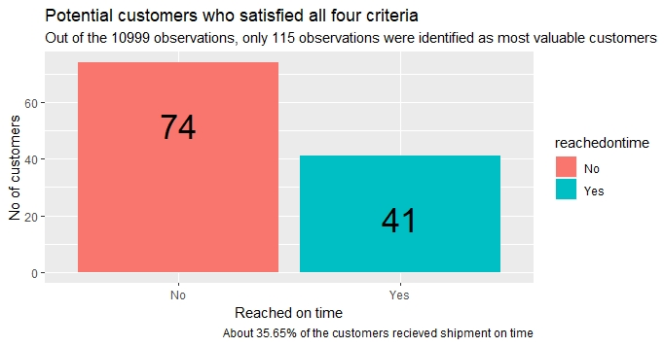
This is an additional analysis. Here I filtered a subset from the original dataset that contained observations that satisfied all the previously chosen criteria. The subset was called “mostvaluable_customers”, as they brought more value to the company.
The target variable classes were labelled as Yes for 0 and No for 1. 0 indicates reached on-time, and 1 indicates not reached on-time.
INSIGHTS
Here 35.65% indicates on-time delivery rate, which is very low compared to delayed delivery rate which was found to be 64.34%.
Shipments have not been reaching on time even for the most valuable customers.

Slide 27
Problem statement 3 and insights
Problem statement: Create segmentation of the customers to whom the shipments have not reached on-time. Use only delayed customers data for clustering.
As it was advised to use only the delayed customers data, a subset from the original dataset was filtered to satisfy this requirement. The class 0 in the target variable indicates shipments reached on-time. Hence, for the customer segmentation, only those observations were required whose outcome was 1, which indicated delay or didn’t reach on-time.
Variables that were directly related to or impacted the customers were chosen for the analysis. They are: Customer care calls, customer rating, prior purchase, cost of the product, discount offered, and gender. We will be able to understand various customer profiles.
Variables were scaled before proceeding with the analysis.
The clustering methods used in this project were Hierarchical clustering and K-means clustering.
Hierarchial clustering was implemented first. A dendrogram was plotted and it was observed that the tree could be cut into three groups/clusters.
K-means clustering was implemented next. The information about cluster groups from the Hierarchial clustering was leveraged, as the centers were initialized at 3. An elbow chart was plotted and it was observed that 3-cluster segmentation is the solution.

Slide 28
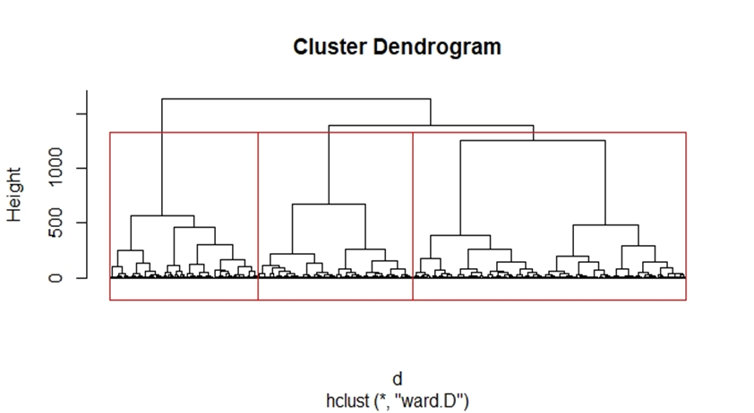
1. Hierarchical clustering
From the dendrogram, we can interpret that the dataset can be segmented into three clusters.

Slide 29
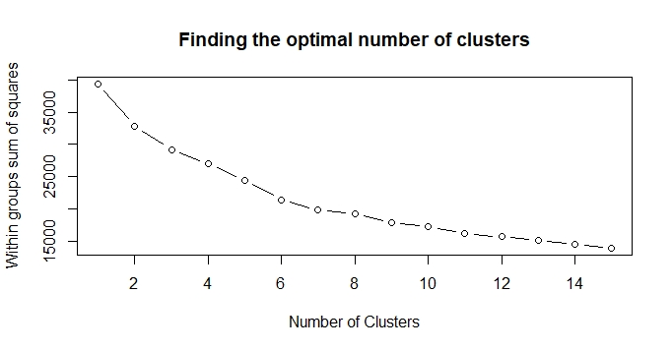
2. K-means clustering
From the elbow chart, it is observed that WSS significantly decreases after 3 . Hence the optimal number of clusters was chosen as 3.

Slide 30
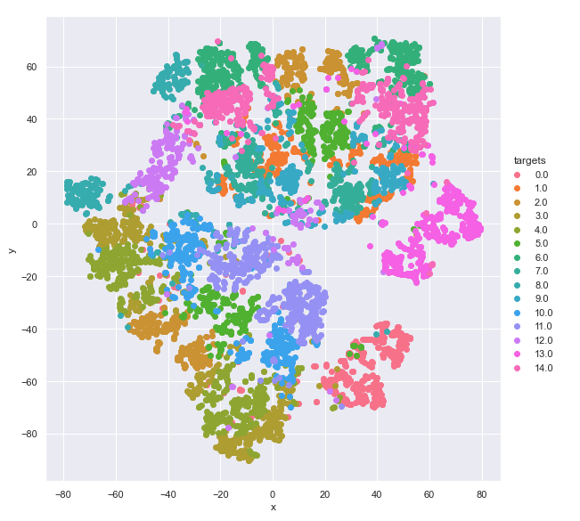
These graphs show the customer grouping for 14 cluster

Slide 31
Cluster Profiles – Hierarchical clustering
Insights | Cluster 1 | Cluster 2 | Cluster 3
Size of the cluster | 1767 | 1684 | 3112
Customer care calls | Most customers made 3 calls | Most customers made 5 calls | Most customers made 3 calls to the customer care
Customer rating | Most of the customers were rated 2 | Most of the customers were rated 5 | Most of the customers were rated 3
Median cost of the product | $ 198 | $ 244 | $ 197
Prior purchase | Most of the customers made 3 prior purchases | Most of the customers made 4 prior purchases | Most of the customers made 3 prior purchases
Gender | Majority of customers in cluster 1 are male. | Majority of customers in cluster 2 are female. | Majority of customers in cluster 3 are male.
Median discount value | 46 % | 7 % | 7 %

Slide 32
Cluster Profiles – K means Clustering
Insights | Cluster 1 | Cluster 2 | Cluster 3
Size of the cluster | 1552 | 2504 | 2507
Customer care calls | Most customers made 5 calls | Most customers made 3 calls | Most customers made 3 calls to the customer care
Customer rating | Most of the customers were rated 5 | Most of the customers were rated 3 | Most of the customers were rated 3
Median cost of the product | $ 253 | $ 196 | $ 192
Prior purchase | Most of the customers made 4 prior purchases | Most of the customers made 3 prior purchases | Most of the customers made 3 prior purchases
Gender | Majority of customers in cluster 1 are female. | Majority of customers in cluster 2 are male. | Majority of customers in cluster 3 are male.
Median discount value | 6 % | 10 % | 10 %

Slide 33
Problem statement 4 and insights
Problem Statement : Do a Sentiment analysis(Positive or Negative) of the competitors - Amazon India, Flipkart, and Snapdeal. Use tweets to perform the analysis.
Data was fetched from Twitter via the Twitter API. This was made possible by the twitteR package in R.
2000 tweets were requested for each of the search terms – “amazon IN”, “flipkart”, and “Snapdeal”.
A search for “Snapdeal” yielded 1381 observations.
Data were pre-processed before analysis. Retweet entity, handle info, punctuation, numbers, URLs, special characters, emojis, duplicates due to retweets were all removed.
Sentiments were extracted by using the get_nrc_sentiment() function from the syuzhet package.

Slide 34
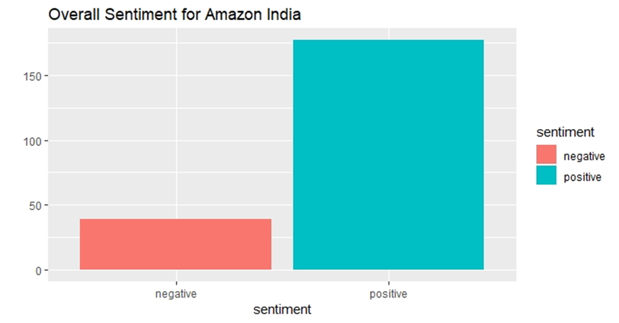
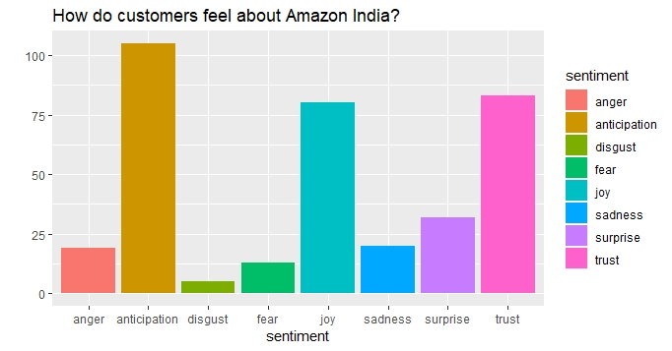
Sentiment Analysis of Amazon India
Customers are happy, and trust the brand. They remain anticipated by what Amazon India has to offer.
Overall sentiment is positive.

Slide 35
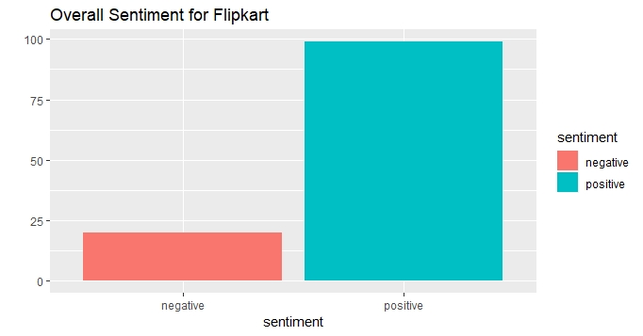
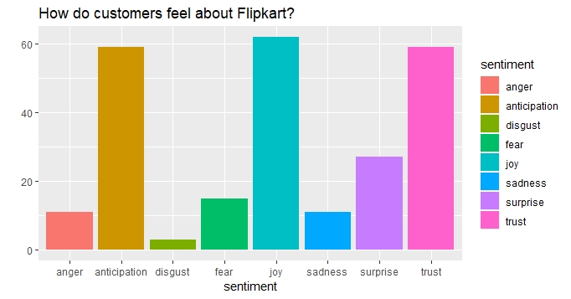
Sentiment Analysis of Flipkart
Customers are very happy, and trust the brand. They remain anticipated by what Flipkart has to offer.
These prominent positive emotions are common for both Amazon India and Flipkart. However, Flipkart enjoys better impression.
Overall sentiment is positive.

Slide 36
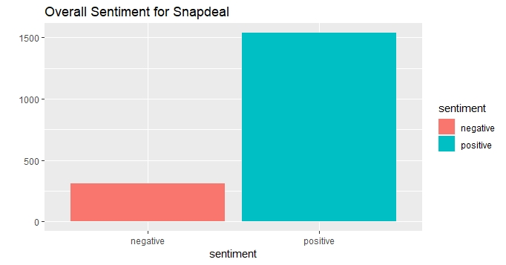
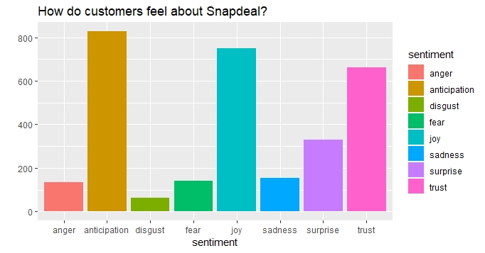
Sentiment Analysis of Snapdeal
The same positive emotions – joy, trust, and anticipation are observed for Snapdeal like in the case of Amazon India and Flipkart.
Overall sentiment is positive.

Slide 37
Thank you

